Slide 1
Enterprise-class networking in Azure
Notes:
Information in this document, including URL and other Internet Website references, is subject to change without notice. Unless otherwise noted, the example companies, organizations, products, domain names, e-mail addresses, logos, people, places, and events depicted herein are fictitious, and no association with any real company, organization, product, domain name, e-mail address, logo, person, place or event is intended or should be inferred. Complying with all applicable copyright laws is the responsibility of the user. Without limiting the rights under copyright, no part of this document may be reproduced, stored in or introduced into a retrieval system, or transmitted in any form or by any means (electronic, mechanical, photocopying, recording, or otherwise), or for any purpose, without the express written permission of Microsoft Corporation.
Microsoft may have patents, patent applications, trademarks, copyrights, or other intellectual property rights covering subject matter in this document. Except as expressly provided in any written license agreement from Microsoft, the furnishing of this document does not give you any license to these patents, trademarks, copyrights, or other intellectual property.
The names of manufacturers, products, or URLs are provided for informational purposes only and Microsoft makes no representations and warranties, either expressed, implied, or statutory, regarding these manufacturers or the use of the products with any Microsoft technologies. The inclusion of a manufacturer or product does not imply endorsement of Microsoft of the manufacturer or product. Links may be provided to third party sites. Such sites are not under the control of Microsoft and Microsoft is not responsible for the contents of any linked site or any link contained in a linked site, or any changes or updates to such sites. Microsoft is not responsible for webcasting or any other form of transmission received from any linked site. Microsoft is providing these links to you only as a convenience, and the inclusion of any link does not imply endorsement of Microsoft of the site or the products contained therein.
© 2017 Microsoft Corporation. All rights reserved.
Microsoft and the trademarks listed at https://www.microsoft.com/en-us/legal/intellectualproperty/Trademarks/Usage/General.aspx are trademarks of the Microsoft group of companies. All other trademarks are property of their respective owners.

Slide 2
Abstract and learning objectives
Abstract
Students will learn how to setup and configure a Virtual Network with Subnets in Azure. Students will also learn how to secure the Virtual Network with Firewall rules and route tables. Additionally, students will set up access to the Virtual Network with a "jump box" and a Site-to-Site VPN connection.
Learning objectives
Attendees will be better able to plan and design Virtual Networks in Azure with peering and multiple subnets to filter and control network traffic. In addition,
Create a Virtual Network and provision subnets with associated Network Security Groups
Create route tables with required routes
Build a management "jump box"
Configure firewall to control traffic flow
Configure Site-to-Site connectivity

Slide 3
Step 1: Review the customer case study
Outcome
Analyze your customer needs
Timeframe
15 minutes

Slide 4
Customer situation Woodgrove Financial Services
In business for over 75 years and is a well-known and respected name brand in the financial industry
Historically risk-averse; helping them survive several financial downturns
Started in the US, but expanded into Mexico 20 years ago
Today they have 224 branches in the US and 64 in Mexico

Slide 5
Customer situation (continued) Woodgrove Financial Services
Headquartered in Chicago, IL
US branches in several states over the north central US
Mexico-based branches are in Mexico City and in the surrounding cities

Slide 6
Customer situation (continued) Woodgrove Financial Services
New president brought on to:
Modernize the image of the bank
Drive efficiencies through use of modern technologies
Lower capital costs
Refocus Woodgrove on its core business

Slide 7
Customer situation (continued) Woodgrove Financial Services
Ten years ago went through a major upgrade of their Ethernet core and WAN between two US datacenters:
Plano, TX
Chicago, IL
Mexico datacenter located in Mexico City

Slide 8
Customer situation (continued) Woodgrove Financial Services
Woodgrove Financial services want to run a marketing web application on the cloud as a pilot basis.
To support their strategy of embracing cloud technologies, Network and security team have agreed not to redirect Internet traffic via their on-premises security gateway for this deployment. They are looking for a Cloud-native security solution. This is something they want to pilot on a low risk workload and it requires a separate cloud deployment.

Slide 9
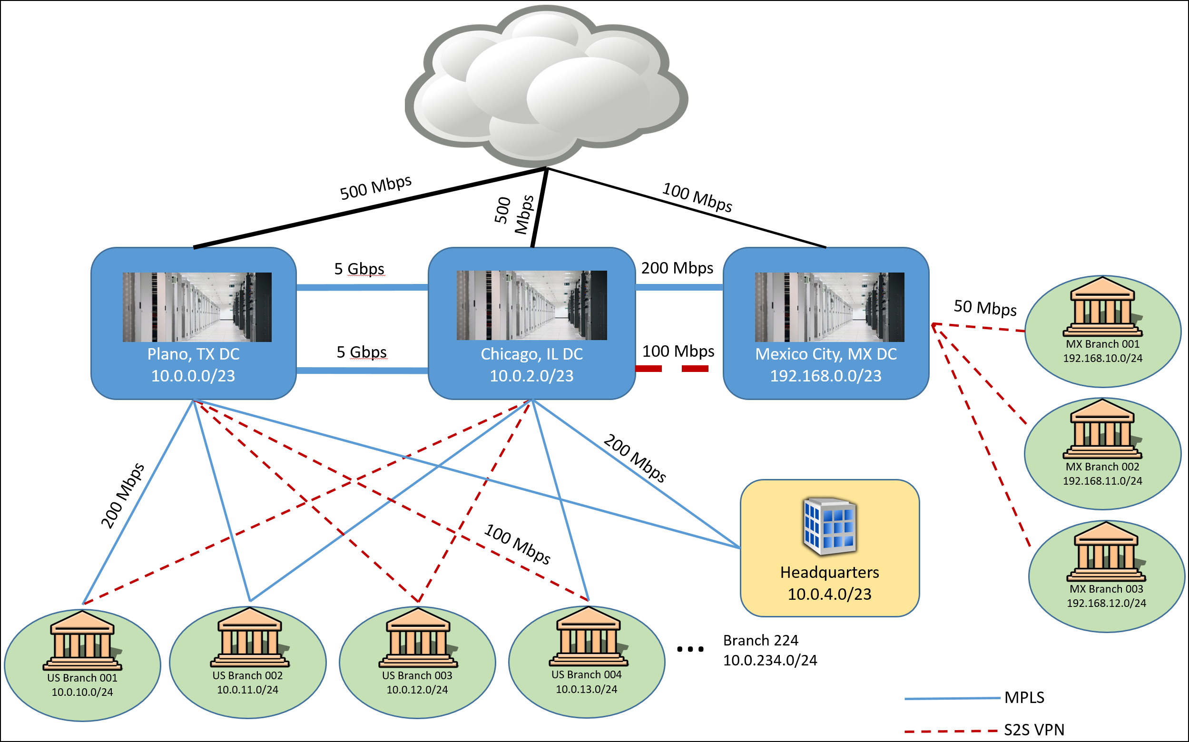
Customer situation (continued) Woodgrove Financial Services
Notes:
United States datacenters have redundant 5 Gbps connections between them
United States branch locations to no less than 100 Mbps with each branch having connectivity to both datacenters
Mexico datacenter has an MPLS connection to the Chicago datacenter with 200 Mbps bandwidth and a Site-to-Site VPN connection for redundancy that is 100 Mbps
All 64 of the Mexico-based branches have Site-to-Site VPN connections to this datacenter and the Internet bandwidth for all branches was standardized recently at 50 Mbps up/down

Slide 10
Business-critical applications Woodgrove Financial Services
Core banking application
Client-server applications
50 application servers and a SQL Server 2014-based data tier (Always on Availability Groups and In-Memory tables)
Banking website
Enables online banking
Running on web farm in the company’s perimeter network and securely interacting with the banking application servers

Slide 11
Business-critical applications Woodgrove Financial Services
HR system
Custom-written; capitalizing on several application servers and an Oracle-based data tier
Email
Exchange Server 2010; capitalizing on DAGs that span their 2 datacenters

Slide 12
Pilot application running on cloud Woodgrove Financial Services
A new application running fully on cloud will be used as their new marketing site.
A cloud-native security solution is required
The application must be fully isolated from their business-critical applications
The application should use PaaS rather than IaaS

Slide 13
Customer needs
Detailed architecture and plan for providing robust, secure connectivity between their datacenters and Azure
Azure Virtual Networking architecture and plan for providing an enterprise-class networking scenario, supporting secure data flow between tiers in an n-tier application

Slide 14
Customer needs
End result is a network design that allows applications to run both on-premises and in Azure
Outbound Internet traffic must be passed through an on-premises intrusion detection/prevention system in order to comply with company policy
Also all the incoming web traffic needs to be inspected in order to make sure it blocks sql injections, cross – site scripting and other web attacks such as http protocol violation.

Slide 15
Customer needs
For the new cloud application, related PaaS services need to be deployed in order to run the application
Traffic going to the new application will not be redirected to the on-premises corporate network
Instead, Woodgrove are looking to deploy a cloud-native security solution for this pilot
The web app architecture requires URL-based routing, redirection, and SSL termination

Slide 16
Customer objections
Tight regulatory compliance requirements:
Security must be a key tenant of all operations including those related to technology
CSO is opposed to using services solely accessible over the public Internet (Office 365, CRM, and other Microsoft SaaS are off limits)
PaaS services accessible over the Internet are also unusable
Relegated Woodgrove to “private” Azure services such as IaaS

Slide 17
Customer objections
Director of Network Operations believes complex “Enterprise-grade” networking scenarios cannot be deployed in Hyper-Scale Public Clouds
Director of Network Operations requires that engineers have the ability to analyze traffic flows and capture packets when needed
Need to provide detailed solution plans, case studies, and customer testimonials to help better understand

Slide 18






Common scenarios
Azure Infrastructure as a Service (IaaS)
Virtual machines
Virtual networks
VPN gateway
Virtual Appliances
Hybrid connectivity
Load balancers
Storage
Web Application Firewall

Slide 19
Step 2: Design the solution
Outcome
Design a solution and prepare to present the solution to the target customer audience in a 15-minute chalk-talk format.
Timeframe
60 minutes
Business needs (10 minutes) | Respond to questions outlined in your guide and list the answers on a flipchart.
Design (35 minutes) | Design a solution for as many of the stated requirements as time allows. Show the solution on a flipchart.
Prepare (15 minutes) | Identify any customer needs that are not addressed with the proposed solution. Identify the benefits of your solution. Determine how you will respond to the customer’s objections. Prepare for a 15-minute presentation to the customer.

Slide 20
Step 3: Present the solution
Outcome
Present a solution to the target customer in a 15-minute chalk-talk format
Timeframe
30 minutes (15 minutes for each team to present and receive feedback)
Directions
Pair with another table
One table is the Microsoft team and the other table is the customer
The Microsoft team presents their proposed solution to the customer
The customer asks one of the objections from the list of objections in the case study
The Microsoft team responds to the objection
The customer team gives feedback to the Microsoft team

Slide 21
Wrap-up
Outcome
Identify the preferred solution for the case study
Identify solutions designed by other teams
Timeframe
15 minutes

Slide 22
Preferred target audience
Director of Network Operations
Corporate Security Officer
Corporate Compliance Officer

Slide 23
Preferred solution
The solution for Woodgrove involved several technologies, including:
ExpressRoute with private and Microsoft peering with route filters, enabling connectivity to VMs & VNets
End-to-end encryption of the ExpressRoute traffic enabled by next generation firewalls (NGFW) on both sides of the ExpressRoute connection
Just-in-time access for remote administration of “jump box”
Notes:
https://docs.microsoft.com/en-us/azure/networking/networking-virtual-datacenter

Slide 24
Preferred solution
An enterprise-class configuration within an Azure Virtual Network to support a 3-tier application. Components of this solution include:
Two Virtual Networks configured in a hub-spoke topology
Multiple subnets for the hub and spoke
Hub – Gateway, Perimeter, Management
Spoke – Web tier, Business tier, Data tier
Two NGFWs (NGF), configured in an HA pair, providing hybrid connectivity support and internal firewall capabilities internal to the Azure VNet

Slide 25
Preferred solution
Five Route Tables associated with their corresponding subnets, each with specific User Defined Routes configured
Five Network Security Groups associated with their respective subnets, each with specific allow/deny rules configured
Four internal Azure load balancers to direct load to the primary NGFW and to servers in each application tier
One Azure Web Application firewall that will protect and inspect incoming traffic

Slide 26

Woodgrove Bank Network Design
www.woodgrovebank.com
Internet
Traffic Manager
PaaS Services
Chicago
10.0.2.0/23
Azure
Perimeter
Cloud Access
subscription
services
Point
Azure SQL database
Azure Storage
Azure SQL
Datawarehouse
VPN device
Virtual Network
Service Endpoint
Backend Systems
Hub Vnet
Application Vnet
NGFW
10.7.0.0/16
10.10.1.0/24
Gateway subnet
Management
Perimeter
Web tier
Business tier
Data tier
10.7.255.224/27
10.7.0.0/27
10.7.0.32/27
10.10.1.0/27
10.10.1.32/27
10.10.1.64/27
Availability set
HA Pair
Availability
Availability
Availability
set
set
set
Plano
Peering
10.0.0.0/23
Perimeter
Cloud Access
NGFW
services
Point
Azure load
VPN
balancer
Gateway
NGFW
VPN device
Backend Systems
NGFW
Forced Tunneling
Internet Banking
Inspected Traffic
Service Endpoint Traffic

Slide 27
ExpressRoute Configuration Details
Two ExpressRoute circuits will be provisioned
First in Dallas, TX (corresponding to the Plano, TX datacenter)
Level 3 is the communications provider
Second in Chicago, IL (corresponding to Chicago, IL datacenter)
Equinix is the connectivity provider
Capitalizing on different providers will enable Woodgrove to maintain connectivity to Azure even in the case of a catastrophic provider issue.
After study, the Unlimited licensing option with 1 Gbps was chosen for both ExpressRoute circuits. The use of a Microsoft peering path necessitates an ExpressRoute Standard SKU at minimum.
Notes:
Information in this document, including URL and other Internet Web site references, is subject to change without notice. Unless otherwise noted, the example companies, organizations, products, domain names, e-mail addresses, logos, people, places, and events depicted herein are fictitious, and no association with any real company, organization, product, domain name, e-mail address, logo, person, place or event is intended or should be inferred. Complying with all applicable copyright laws is the responsibility of the user. Without limiting the rights under copyright, no part of this document may be reproduced, stored in or introduced into a retrieval system, or transmitted in any form or by any means (electronic, mechanical, photocopying, recording, or otherwise), or for any purpose, without the express written permission of Microsoft Corporation.
Microsoft may have patents, patent applications, trademarks, copyrights, or other intellectual property rights covering subject matter in this document. Except as expressly provided in any written license agreement from Microsoft, the furnishing of this document does not give you any license to these patents, trademarks, copyrights, or other intellectual property.
The names of manufacturers, products, or URLs are provided for informational purposes only and Microsoft makes no representations and warranties, either expressed, implied, or statutory, regarding these manufacturers or the use of the products with any Microsoft technologies. The inclusion of a manufacturer or product does not imply endorsement of Microsoft of the manufacturer or product. Links may be provided to third party sites. Such sites are not under the control of Microsoft and Microsoft is not responsible for the contents of any linked site or any link contained in a linked site, or any changes or updates to such sites. Microsoft is not responsible for webcasting or any other form of transmission received from any linked site. Microsoft is providing these links to you only as a convenience, and the inclusion of any link does not imply endorsement of Microsoft of the site or the products contained therein.
© 2017 Microsoft Corporation. All rights reserved.
Microsoft and the trademarks listed at https://www.microsoft.com/en-us/legal/intellectualproperty/Trademarks/Usage/General.aspx are trademarks of the Microsoft group of companies. All other trademarks are property of their respective owners.

Slide 28



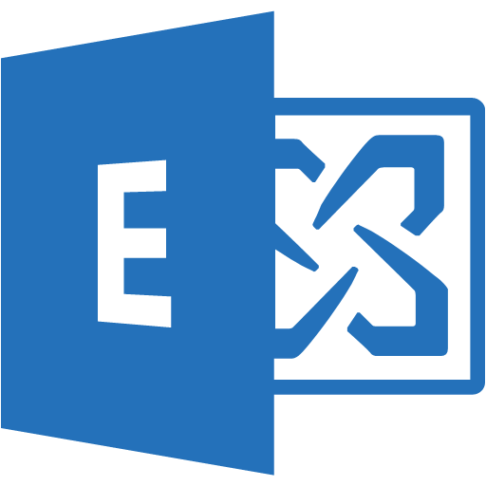
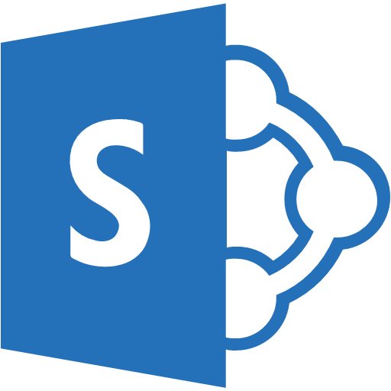














ExpressRoute Peering
Woodgrove’s Network
Partner Edge
Primary Connection
Microsoft Edge
Secondary Connection
ExpressRoute Circuit
Microsoft Peering for Office 365, Dynamics 365, and for Azure pub IPs
Azure Private Peering for Virtual Networks

Slide 29
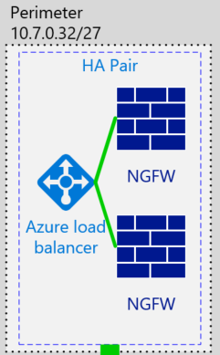
Network Virtual Appliances
Two next-generation firewalls (NGFW) configured in a HA Pair in an Azure Availability Set
Deployed into a Perimeter subnet
Filter traffic coming in from the Internet and from the on-premises environment.
User Defined Routes are leveraged to forward traffic through the devices for inspection
Meets the client’s requirements to use this vendor

Slide 30
Preferred solution for cloud based application
Azure web apps will be configured and used, to run the marketing application pilot
Application GW running as a WAF will be used as the security solution. It will also provide URL-based routing, redirection, and SSL termination
The Azure Web App will be configured as backend back-end pool member of Application GW
To ensure end users will hit the App Gw, a CNAME record can be used to point to the public endpoint of the application gateway
To create the alias, it needs Public IP Address and DNS name attached to the App Gw

Slide 31


Cloud Web App Deployment
Internet
Application Gateway
Web apps
SQL Database
Azure PaaS Services
Azure Pass Services

Slide 32
Preferred objections handling
Objection
Woodgrove is reluctant to use Azure PaaS and SaaS offerings due to the public nature of these services. They are very reluctant for their data to traverse the Internet.
Potential answer
Using ExpressRoute, Woodgrove can access and use Azure private and public services without traversing the Internet. This secure connectivity, in addition to the business-class SLAs and greater bandwidth, make ExpressRoute a compelling offering that addresses this objection.
This can be further refined with the use of Virtual Network Service Endpoints with offerings such as Azure SQL

Slide 33
Preferred objections handling
Objection
Azure cannot support enterprise-class network scenarios.
Potential answer
Azure supports many technologies that enable complex networking scenarios:
Internal and external load balancers
Network Security Groups for traffic filtering
Complex Routing Rules
Network virtual appliances from well-known vendors like Barracuda, Cisco, and Checkpoint, etc.

Slide 34
Preferred objections handling
Objection
We cannot monitor Internet traffic with systems based in Azure.
Potential answer
Azure fully supports forced tunneling ensuring that all Internet traffic is directed to the desired site, be that in an Azure Virtual Network or on-premises.
All Internet traffic can easily be routed from Azure to an on-premises appliance for intrusion detection/prevention and logging.

Slide 35










Preferred objections handling
Objection
Vetting Azure network components will take too long. We already have an approved list of vendors we trust and work with.
Potential answer
The Azure Marketplace has hundreds of solutions from many different vendors.

Slide 36
Preferred objections handling
Objection
We cannot monitor and analyze traffic flows or perform packet capture with systems based in Azure.
Potential answer
Azure supports packet capture through Network Watcher.
Azure has full diagnostic support for traffic flows when Network Security Groups are implemented with NSG flow logs.

Slide 37
Customer quote
Quote from the Network Director:
“Azure’s advanced networking capabilities and support for partner solutions are a welcome surprise. Your proof of concept has clearly demonstrated the platform's ability to more than satisfy our complex requirements.”

